Slide 1

Web Project for Exchange Student
SKKUEXS
김주원 | 서현원 | 이하은 | 한희근

Slide 2
Weekly Progress

Slide 3
Schedule
To – do Week | 3 | 4 | 5 | 6 | 7 | 8 | 9 | 10 | 11 | 12 | 13
Proposal & Study
Data Collecting
Data Processing (NLP)
Front-end (Planning & UI/UX)
Back-end (Server & DB Design)
Beta Test
3

Slide 4
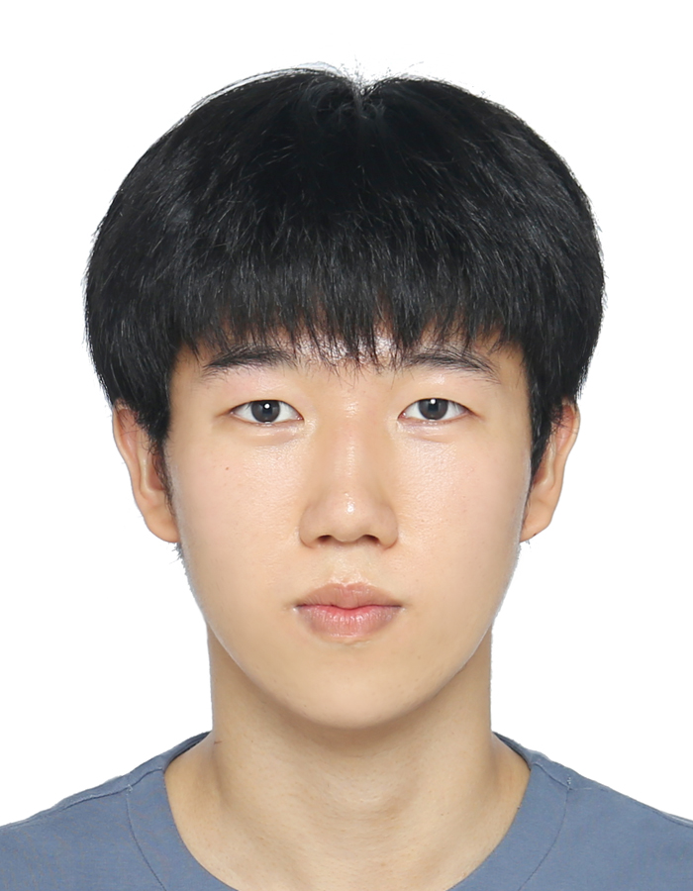


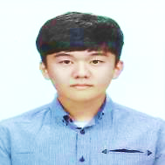
Work Assignment
Juwon Kim
Data Processing(.hwp)
Hyunwon Seo
Data Processing(.pdf)
Haeun Lee
Front-end Design
Huigeun Han
Data Processing
(old format)
4

Slide 5
Data Processing

Slide 6
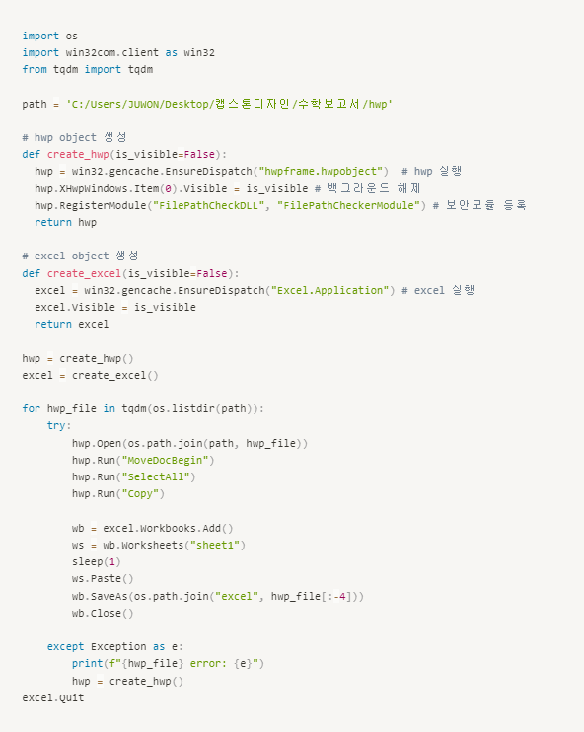
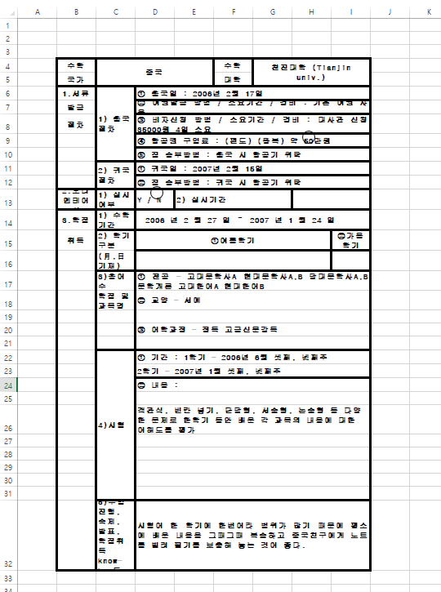


Success rate
830/850
HWP → EXCEL Table

Slide 7
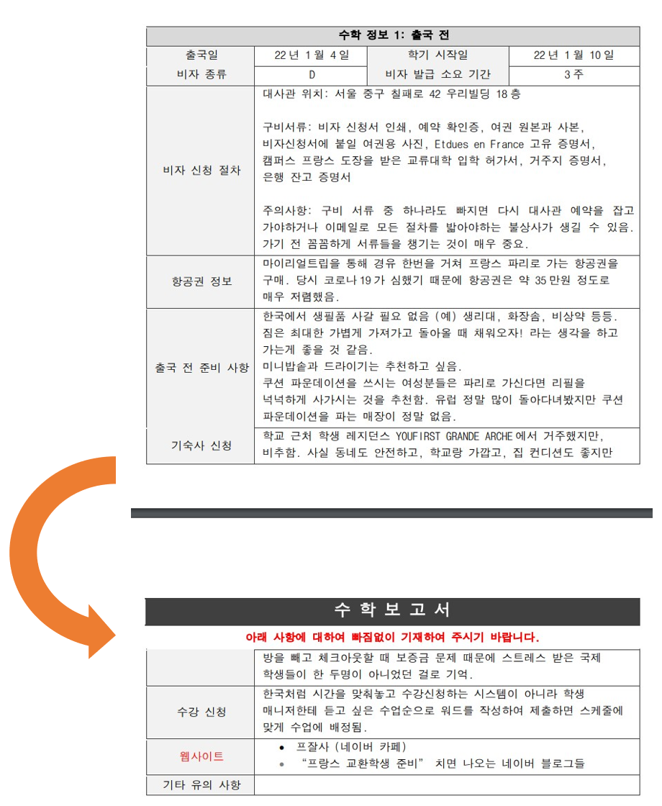

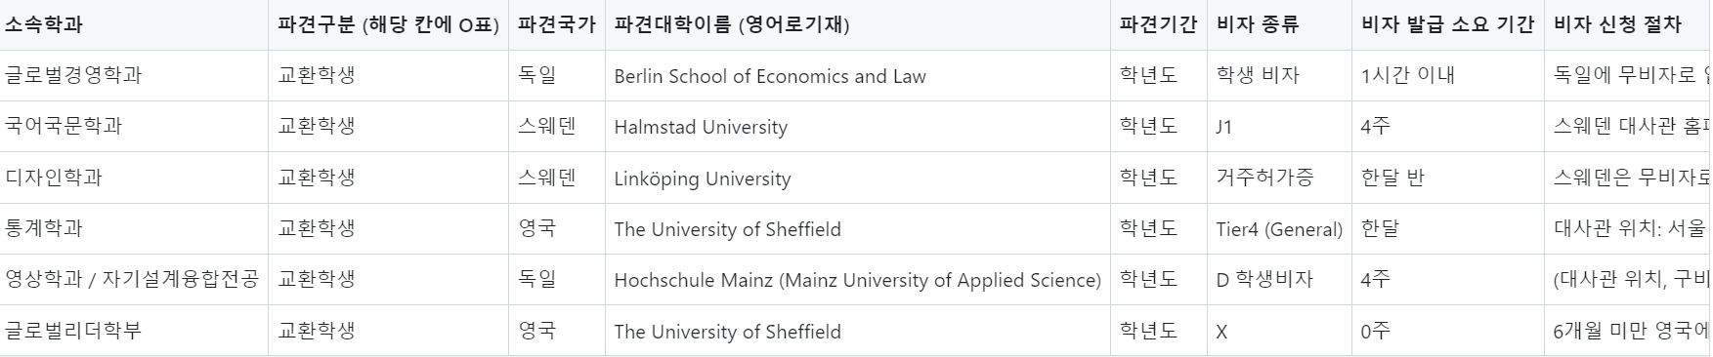

Slide 8
Range of Report date

Slide 9
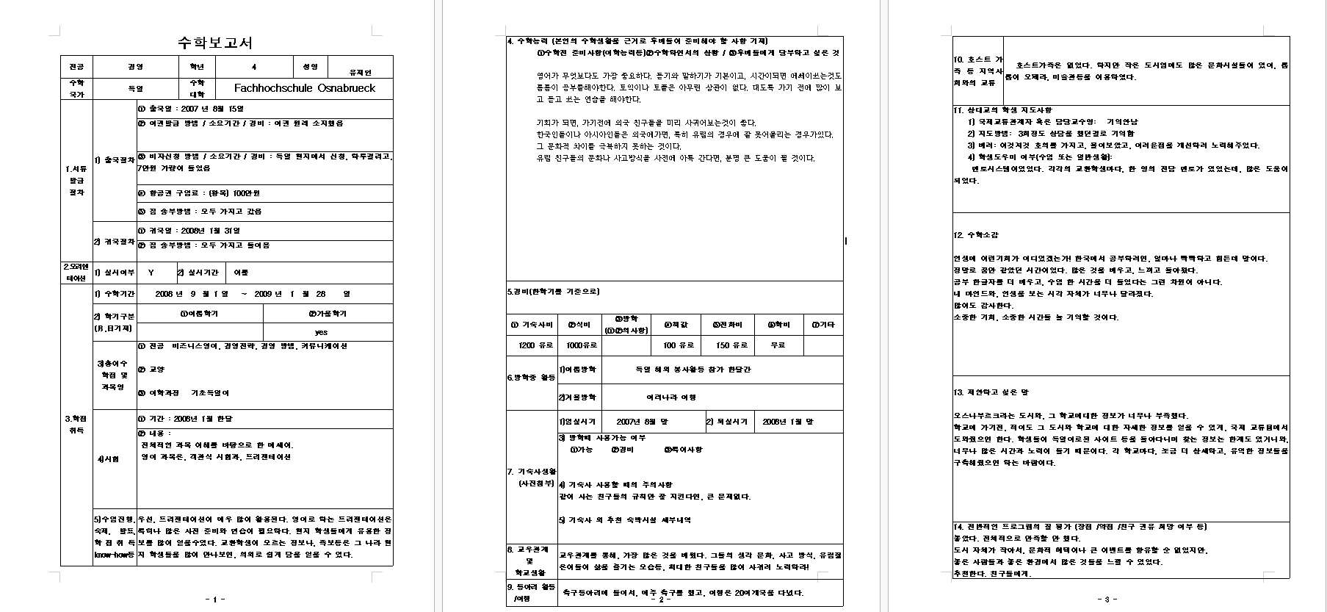
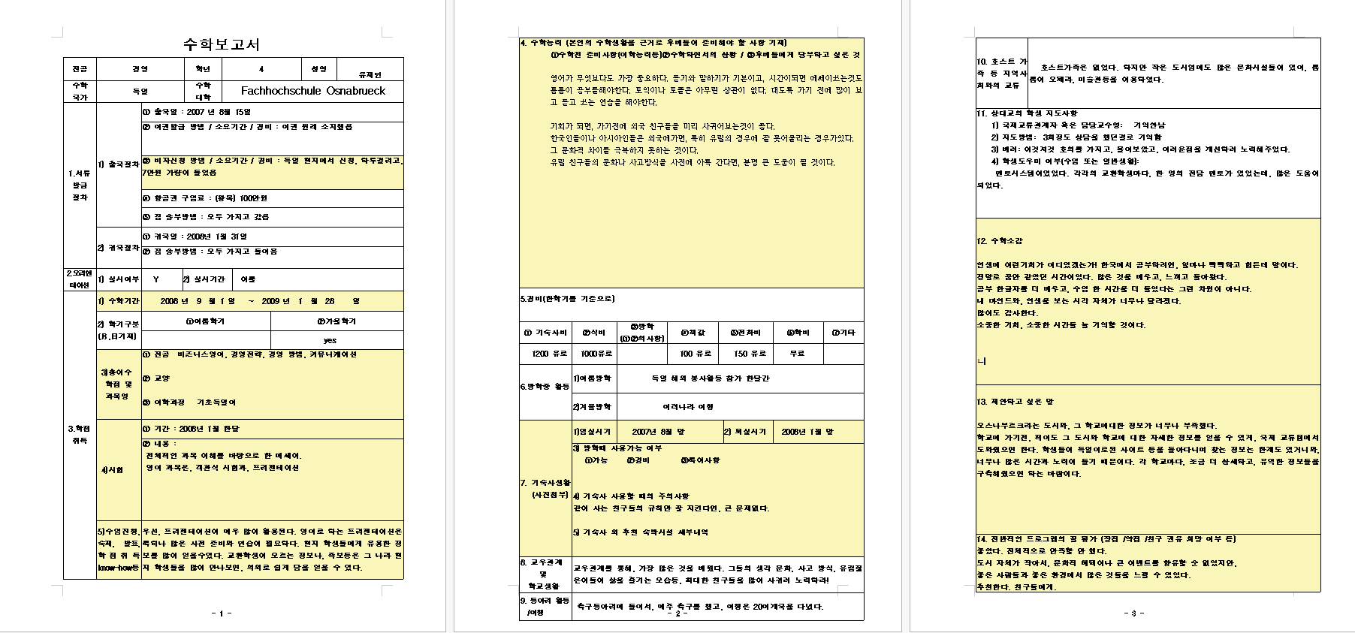

Slide 10

Old Format
.doc
143 files
.hwp
686 files
.docx
369 files
.pdf
< 254 files
10

Slide 11
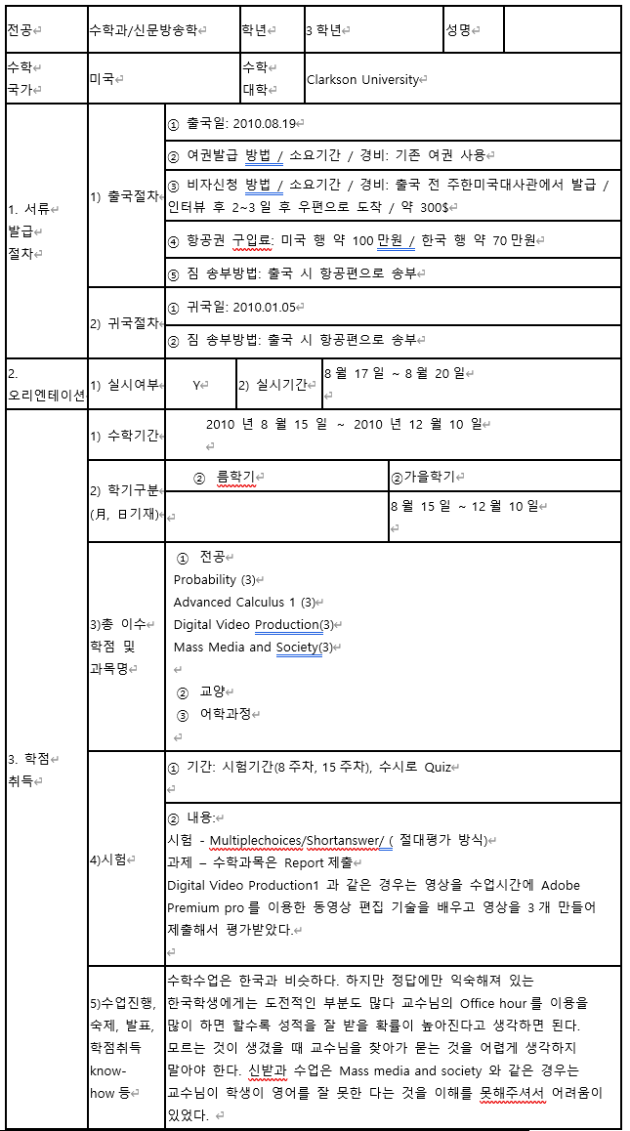
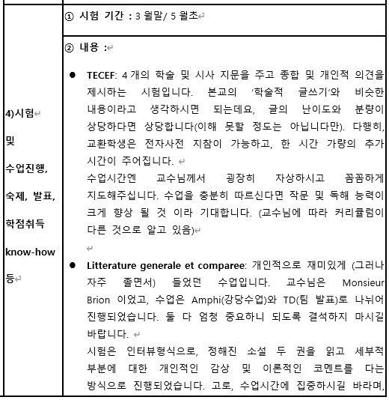
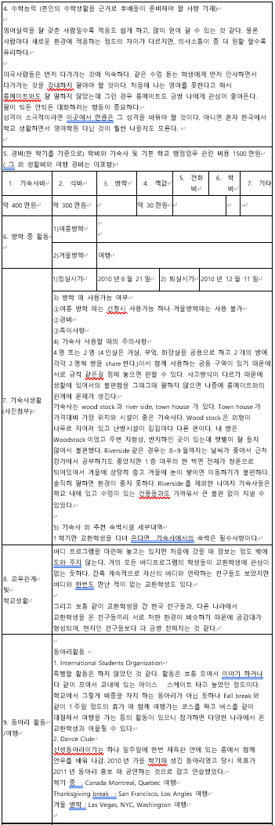
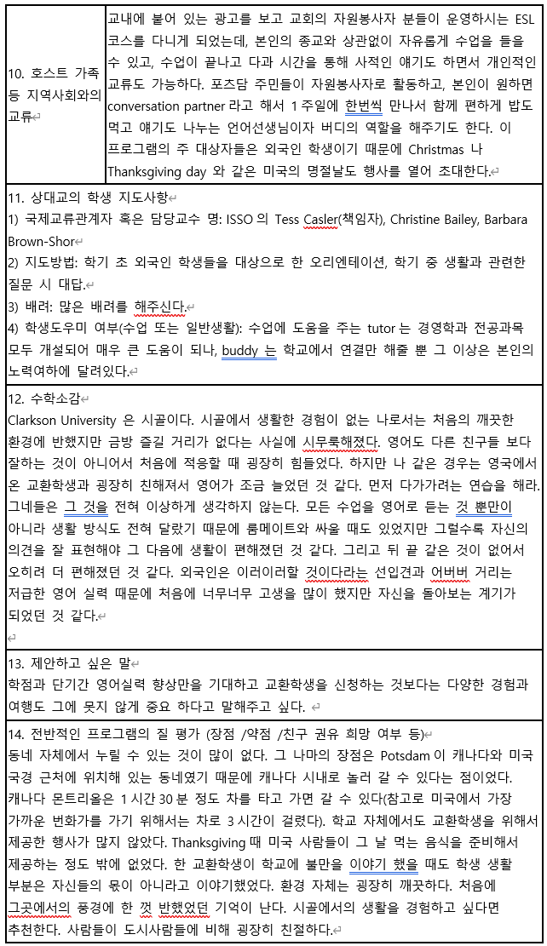
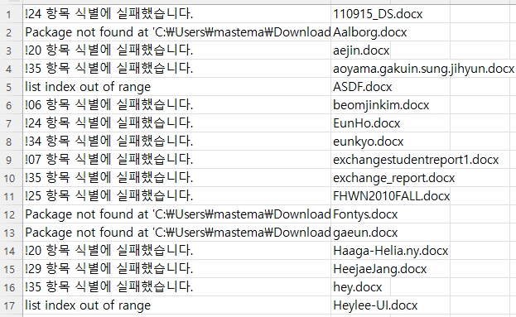
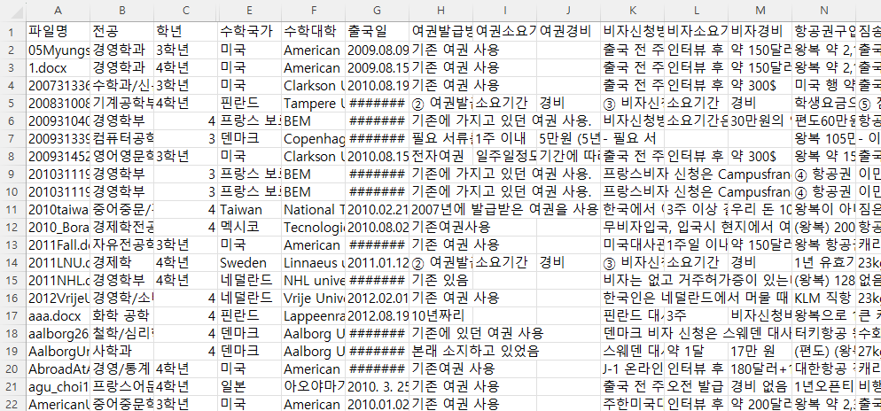
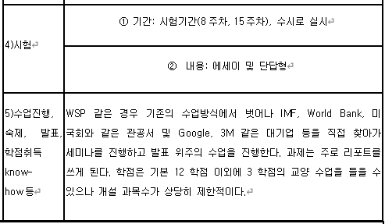
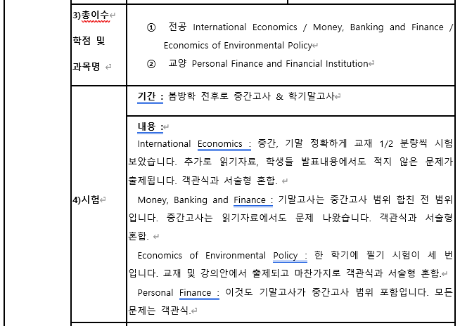
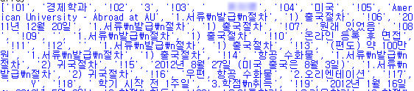
Old Format (.docx)
table[0].rows[1]
table[0].rows[1].cells[1]
293 / 369 (80%)
table[0]
table[1]
table[2]
11

Slide 12
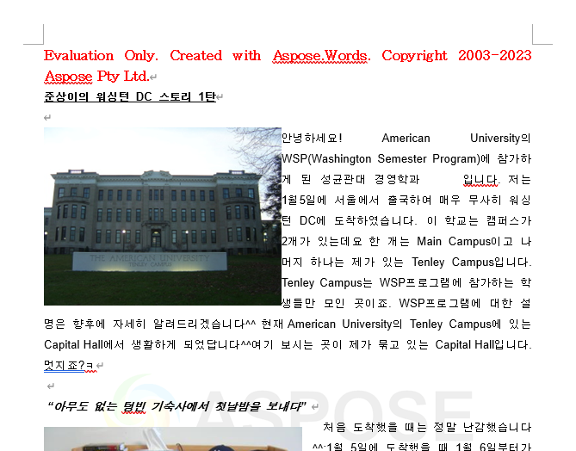
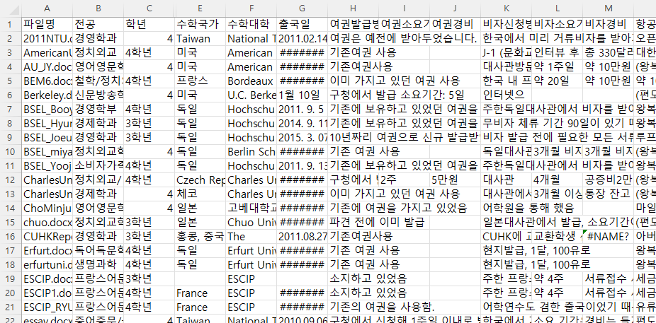
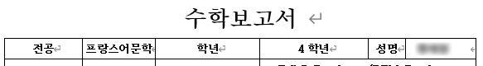
Old Format (.doc)
85 / 128 (66%)
12

Slide 13
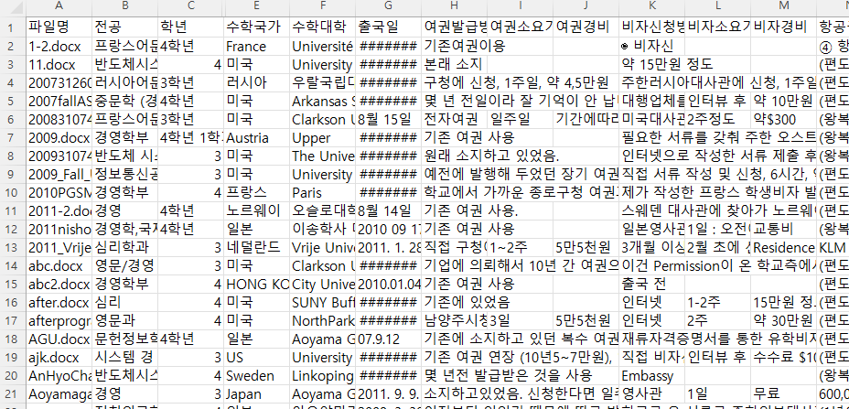
Old Format (.hwp)
? / 686 (?%)
108 / 137 (79%)
13

Slide 14
Summarization

Slide 15
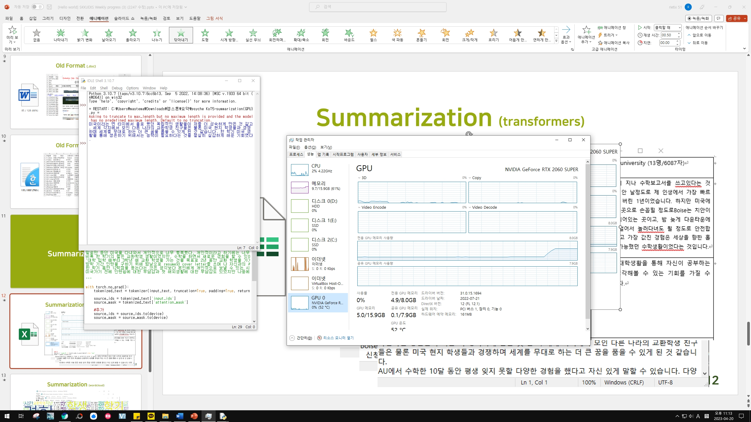
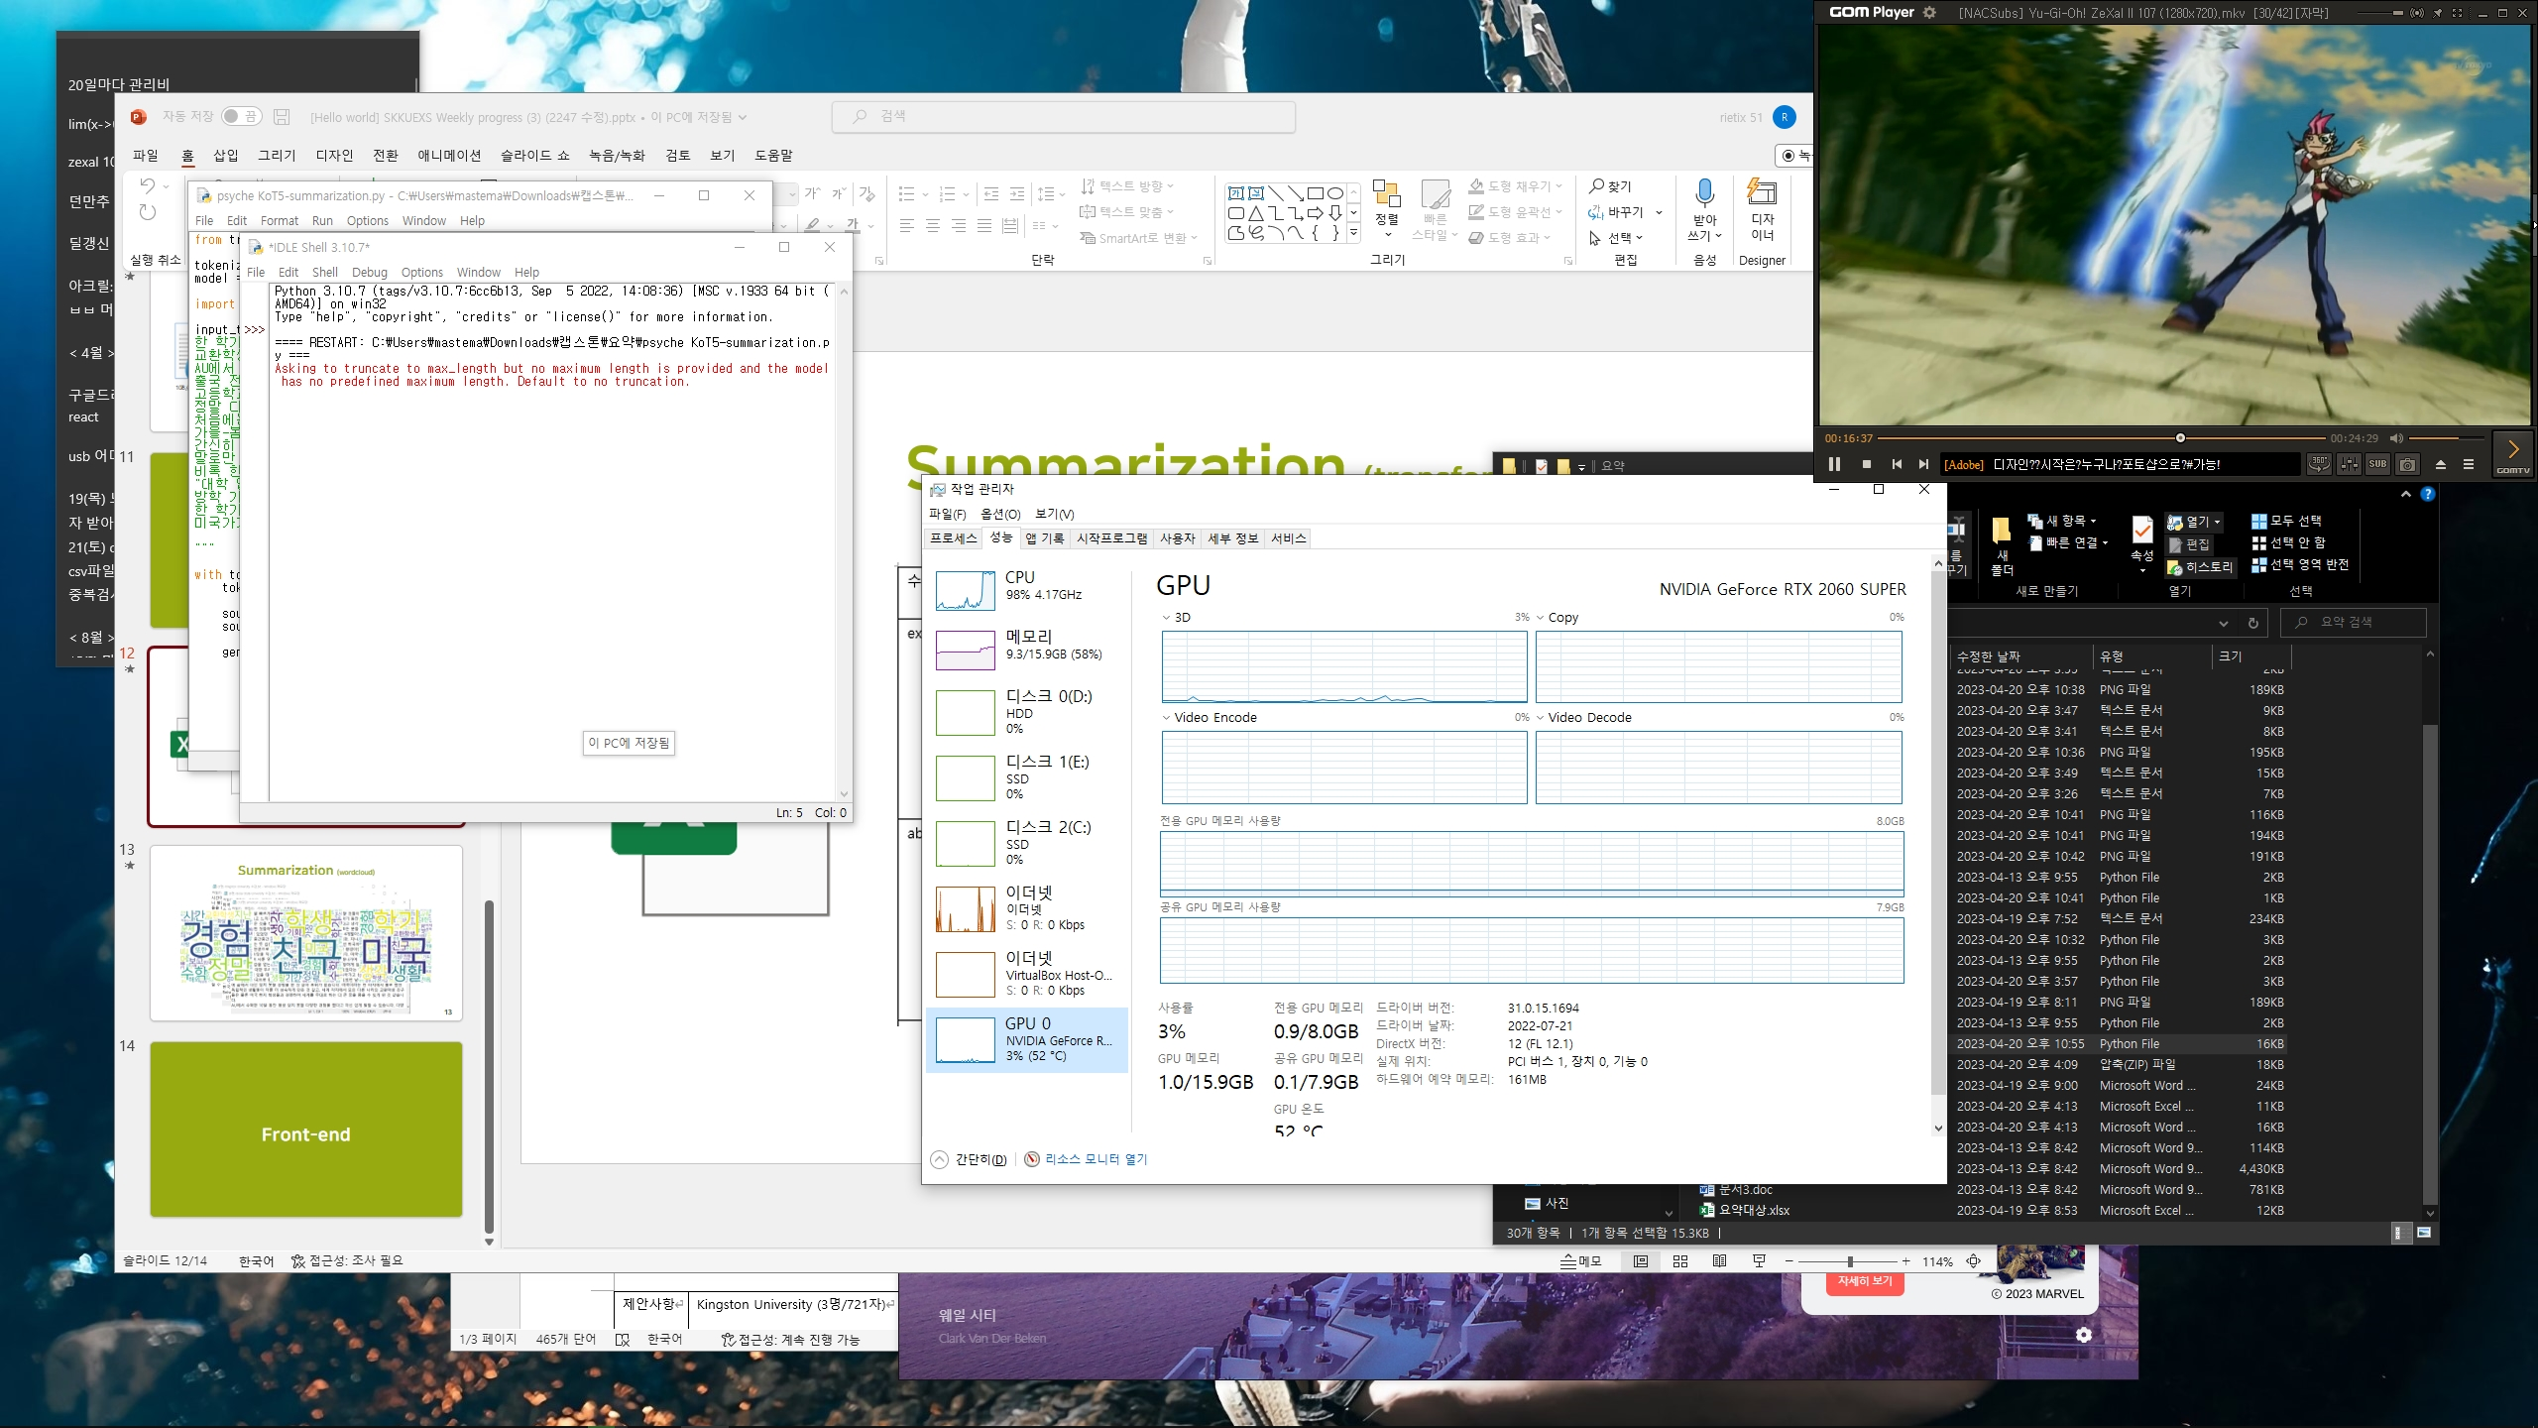
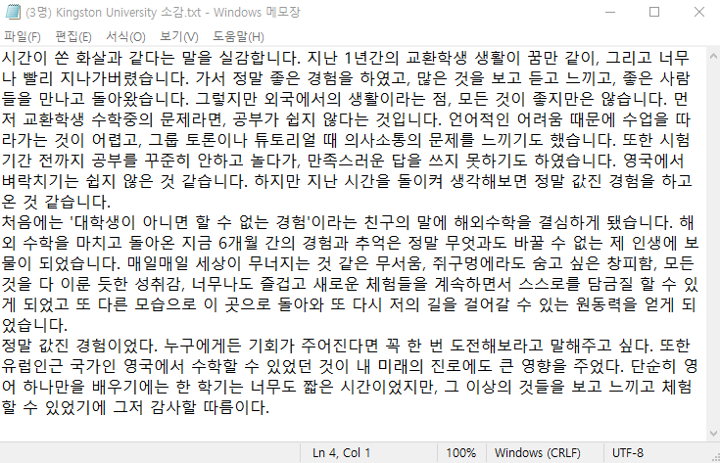
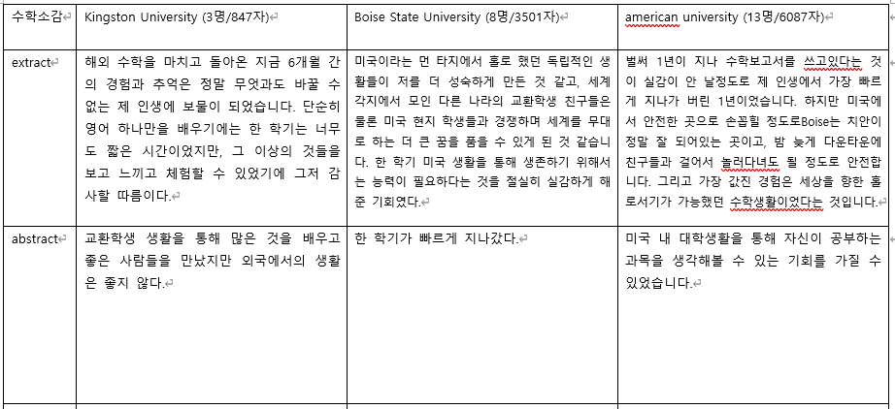
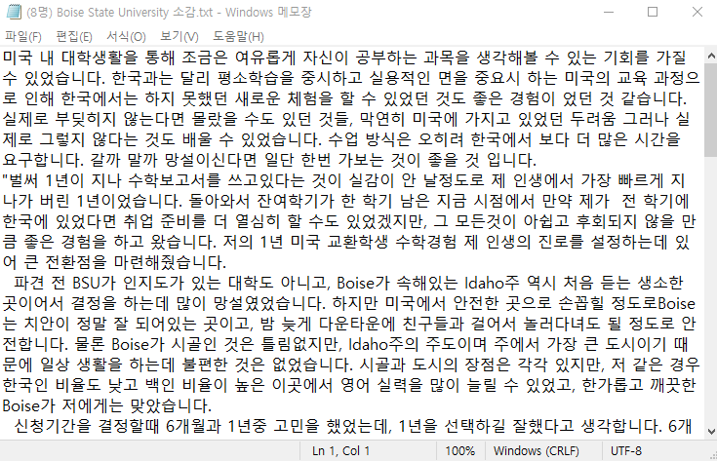
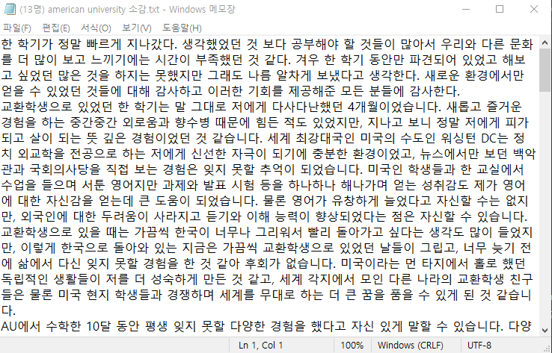

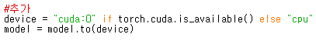
Summarization (transformers)
15

Slide 16



Summarization (wordcloud)
16

Slide 17
Front-end

Slide 18
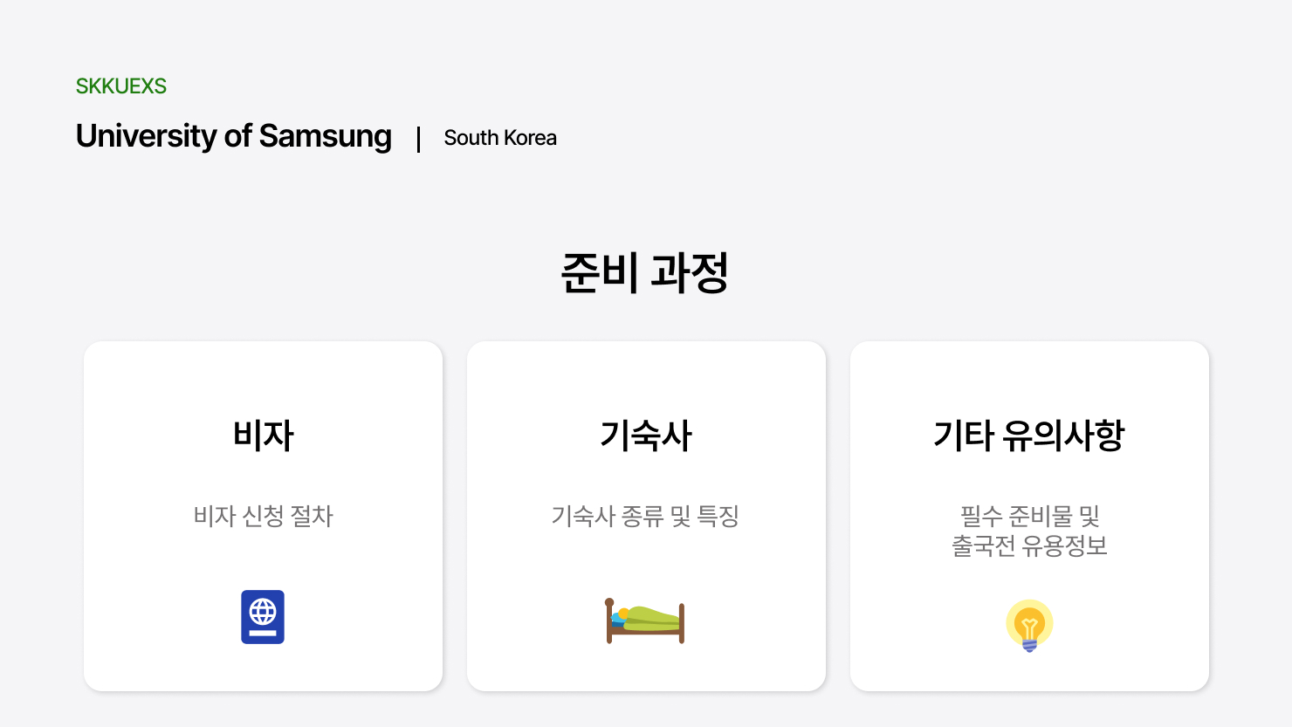

Slide 19
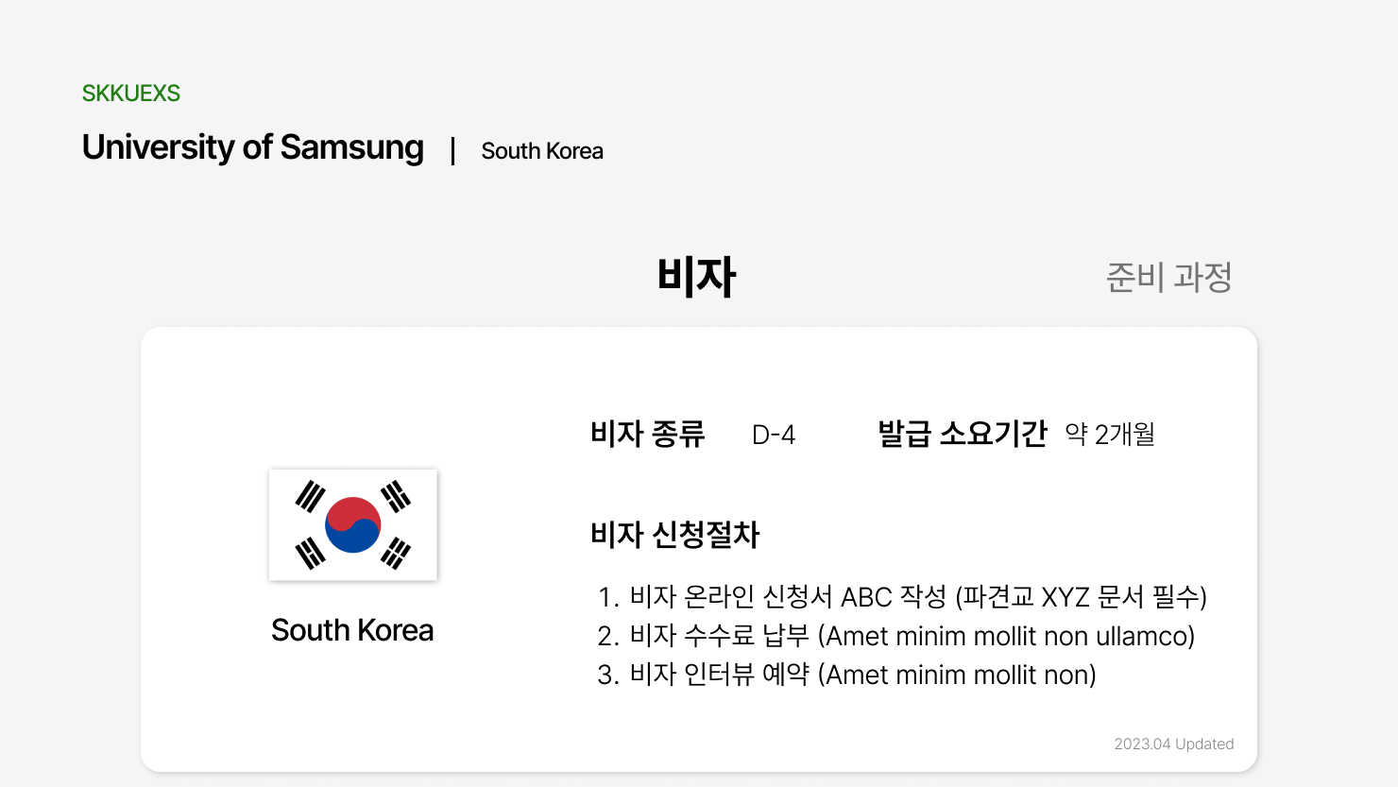

Slide 20
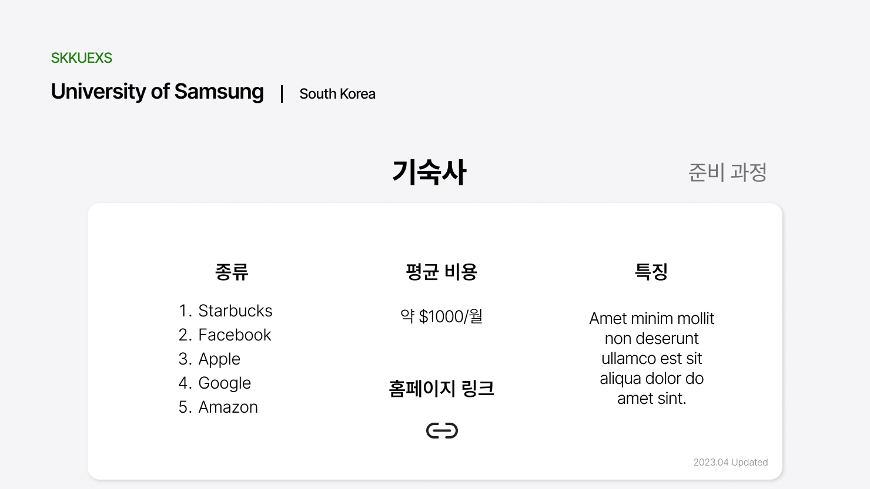

Slide 21
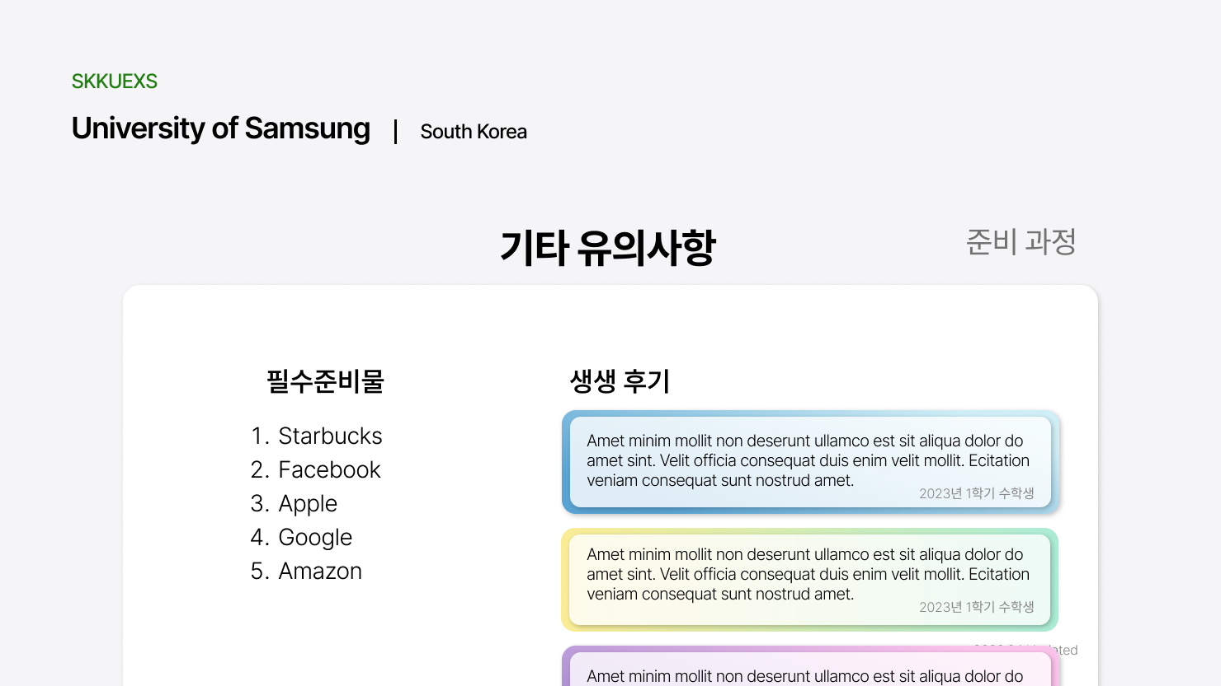

Slide 22
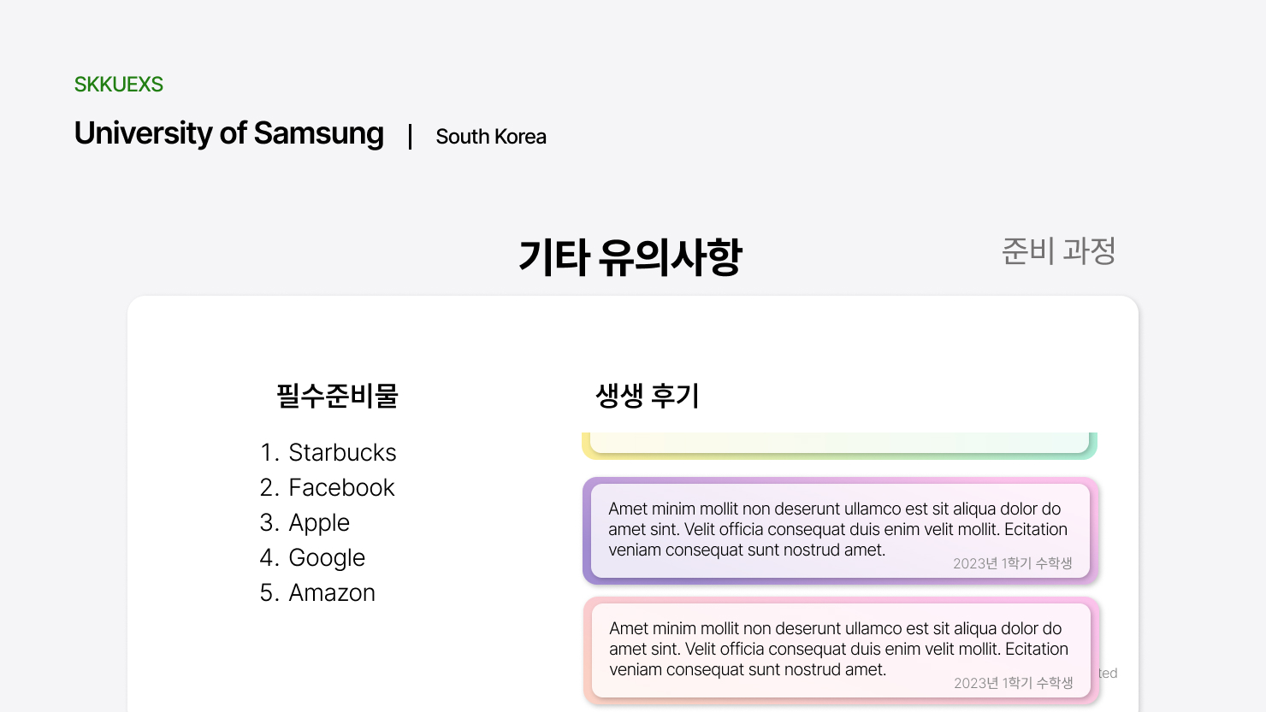

Slide 23
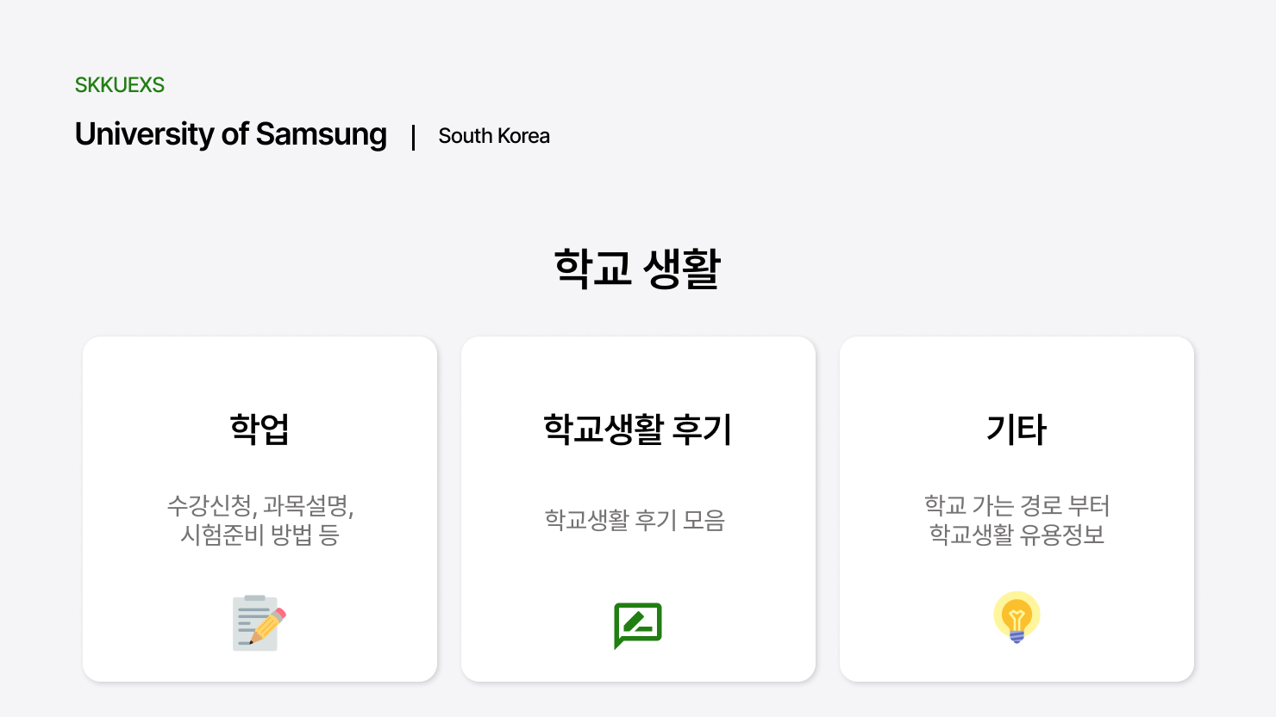

Slide 24
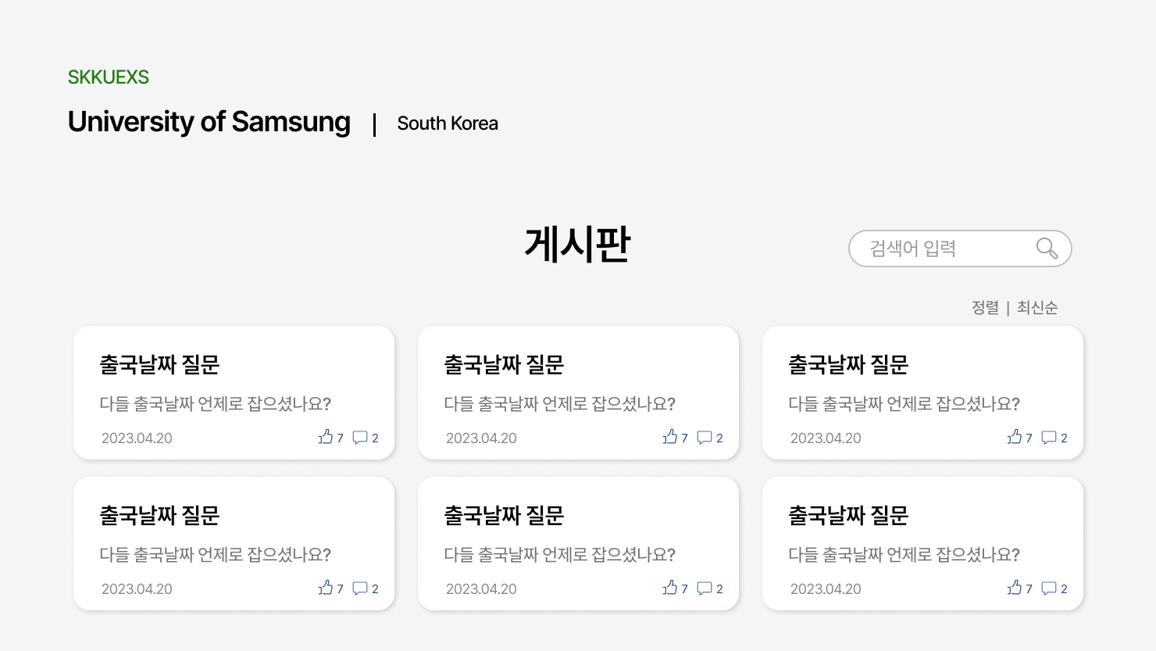

Slide 25
What we’ll do next..

Slide 26
Next Week Plan
Section 1
Front-end
Back-end
Project Overview
Study React
Programming the design
Study Server
Database design
26

